Slide 1
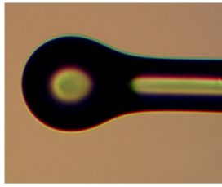
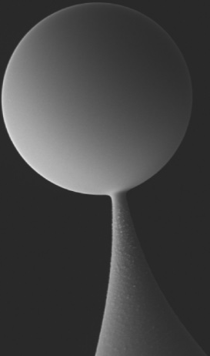
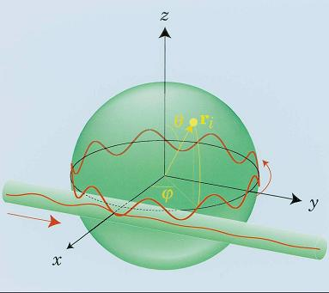
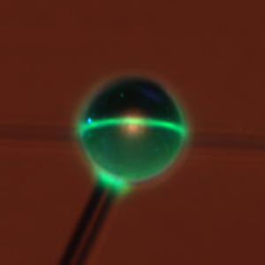
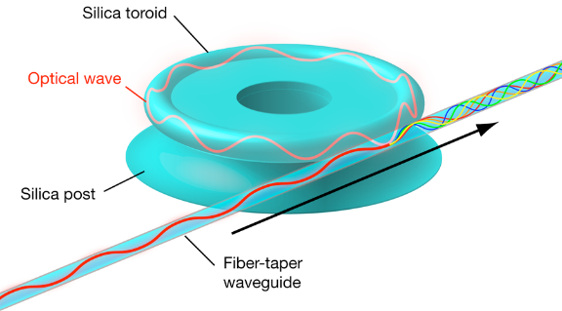
Microsphere Optical Resonator

Slide 2
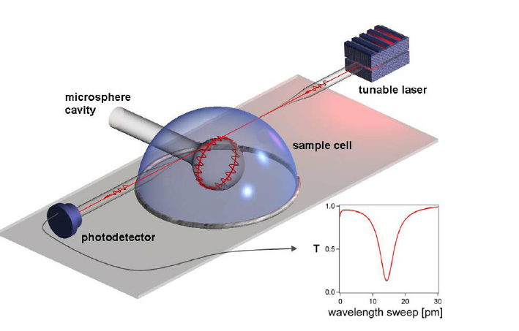
Optical microsphere characterization
Directional Coupling of Evanescent Field
Tunable laser
Fiber Taper

Slide 3
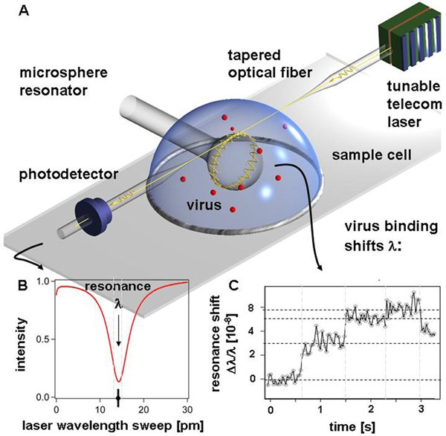
High precision sensors

Slide 4
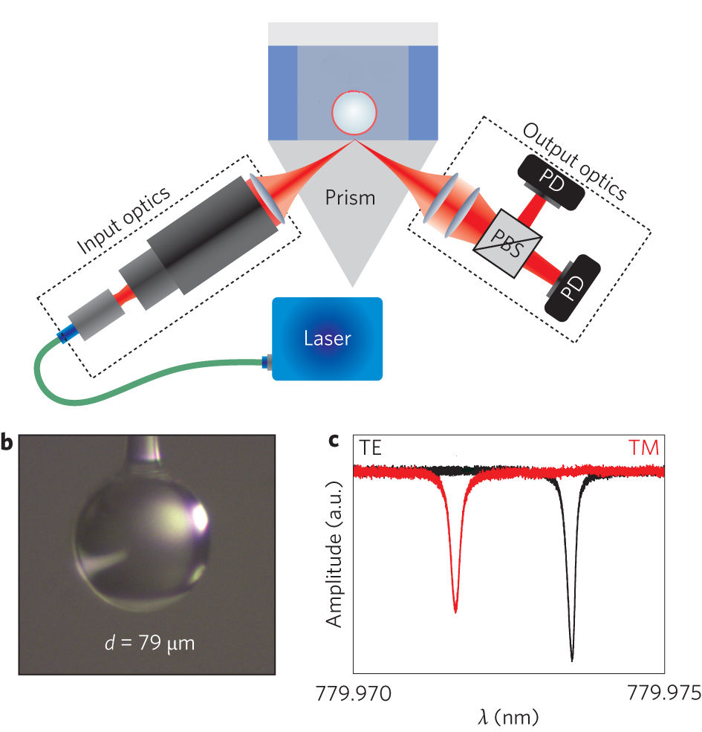
Prism set-up of whispering-gallery-mode sensing

Slide 5
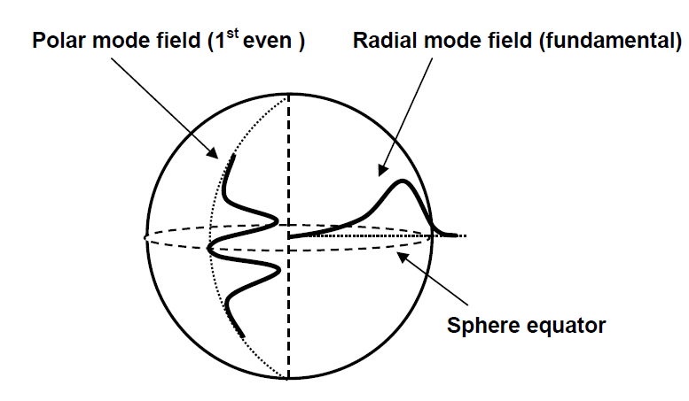
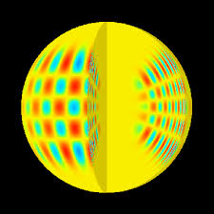
WGM field components in a microsphere
Schematic of WGM field components in a microsphere
resonator (not to scale). Light trapped in the WGM propagates around
the sphere equator in a narrow and thin band, constantly reflecting off
the sphere surface at glancing incidence.

Slide 6
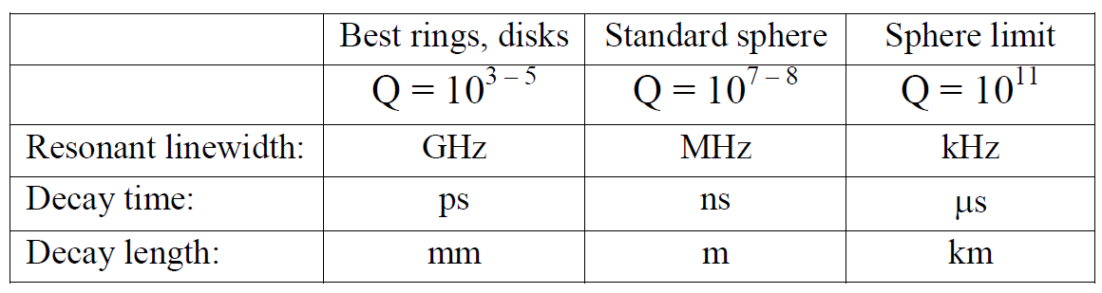
sphere resonator intrinsic Q values
Comparison of ring and sphere resonator intrinsic Q values in
the 1550 nm wavelength range. Theoretical absorption limit for silica
microspheres given in the last column.

Slide 7

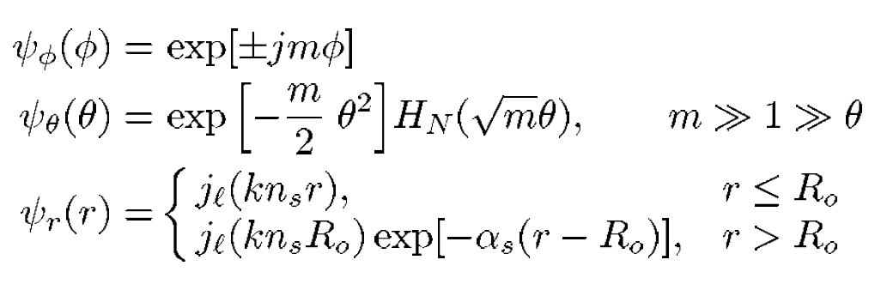
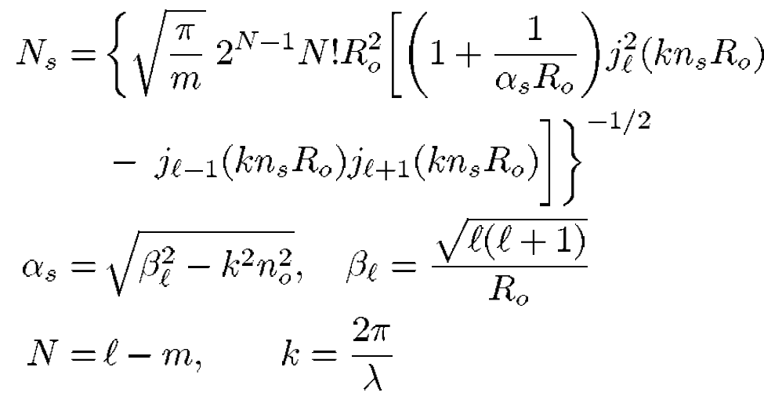
WGM field in a microsphere

Slide 8
